Slide 1
Power BI Dashboard Report Integration

Slide 2


Main Indicators
Power BI Dashboard for followings report
OTD-OTL Report
Planned Vs Executed Volume Report
Waiting Time Report
CXGO Report for Both Segment-Dubai and Abudhabi
Call Center Report
Schedule Availability
EPOD Report
Fleet mgt. and GPS OFF Report
The followings Conceptual design is only for the presentation of idea. We would modify the visual of data according to organizational requirements.

Slide 3
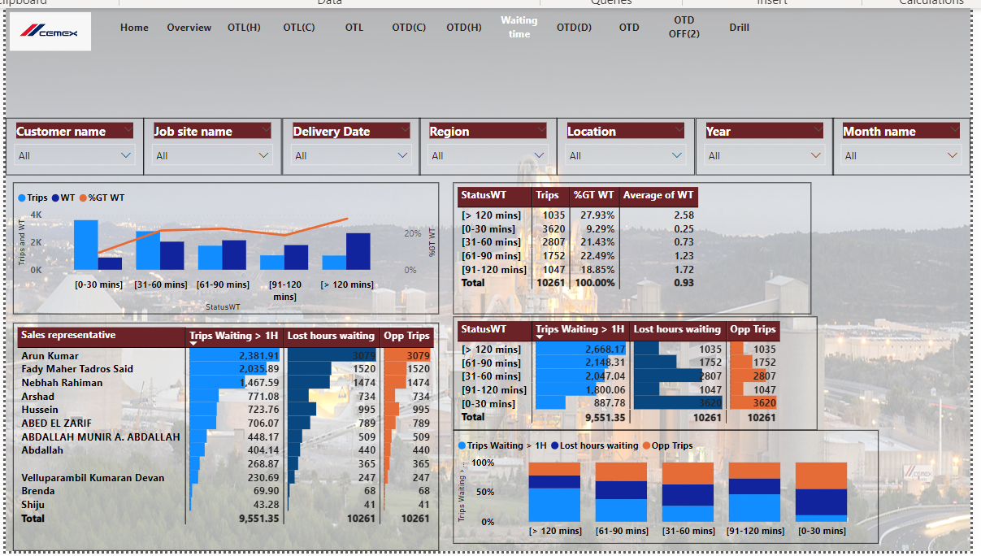
Waiting Time of Truck –Mixer

Slide 4
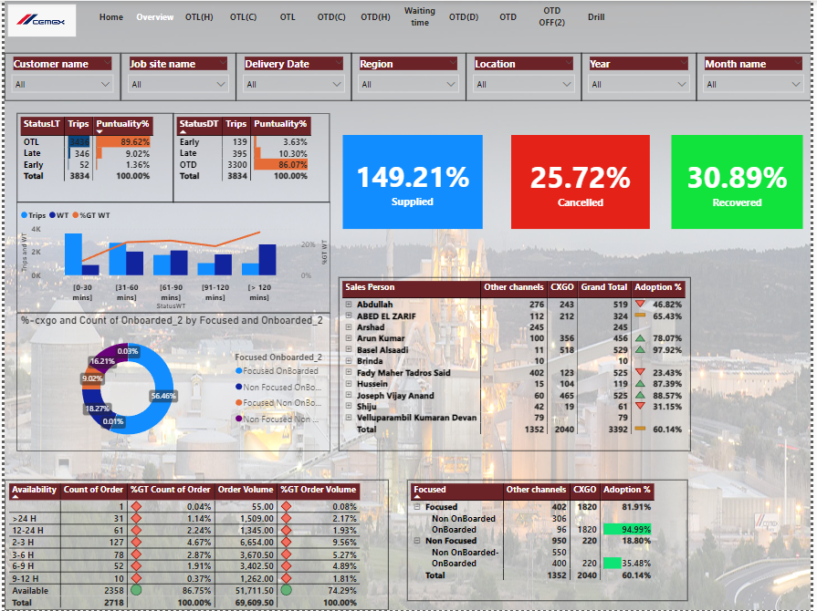
Customer Experience Dashboard

Slide 5
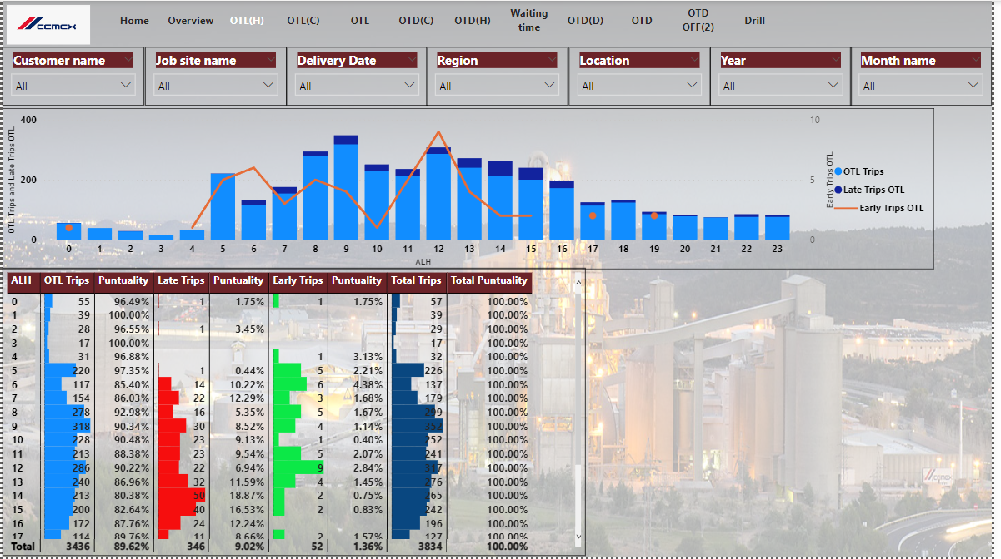
On Time Loading KPI

Slide 6
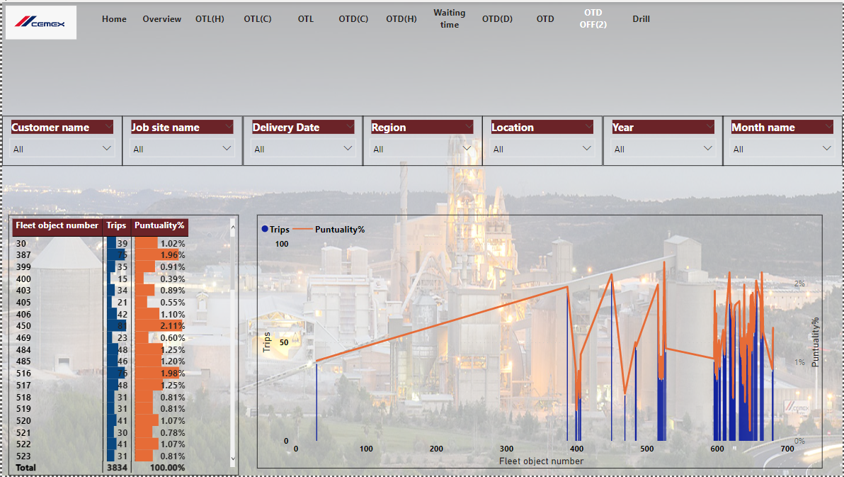
Truck Mixer Performance

Slide 7
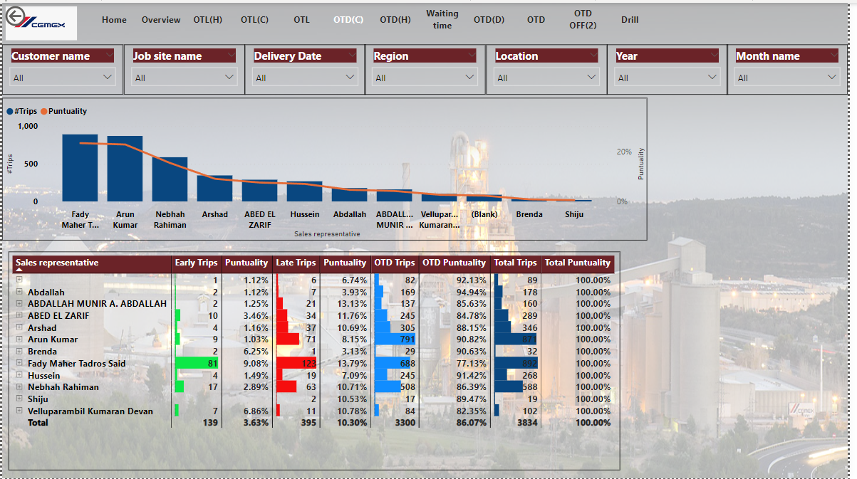
Sales Exe Performance Performance

Slide 8
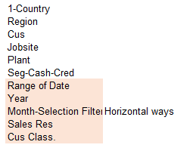
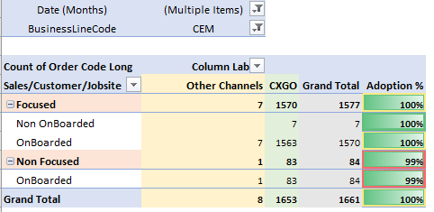
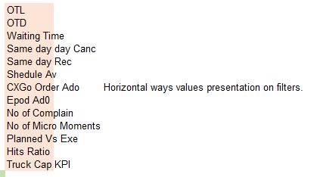
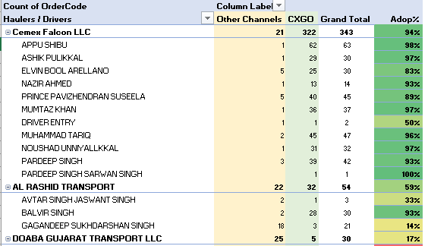
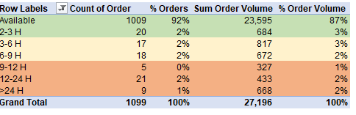
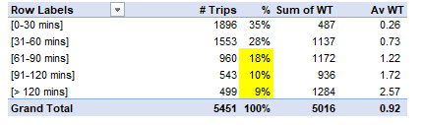
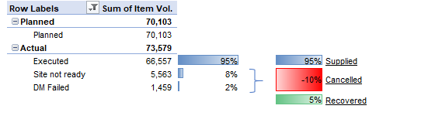
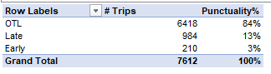
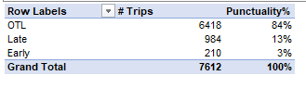
No graph only table presentation

